Slide 1

DrEyeVer
Detecting object on driver’s focus of attention for intelligent vehicles.
2020. 10. 02
Team KaAI
Kookmin Univ.
South Korea

Slide 2
Outline
Contents
Background
Concept
System Configuration Map (UC_win/Road World)
Getting Can data from Driving Simulator
Object Detection from Eye_Tracker Data
Gaze Point Transfomation to UC_win/Road Screen(1)(2)
Demo Scenario (UC_win/Road World)
Applying Eye 4 Vehicles in Real World
System Configuration Map (Real World)
Demo Scenario (Real World)

Slide 3
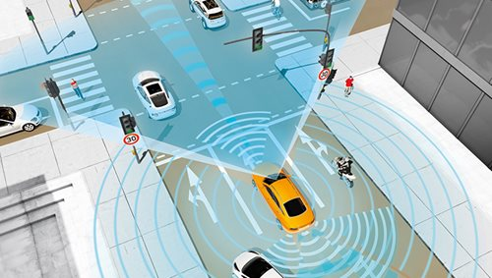
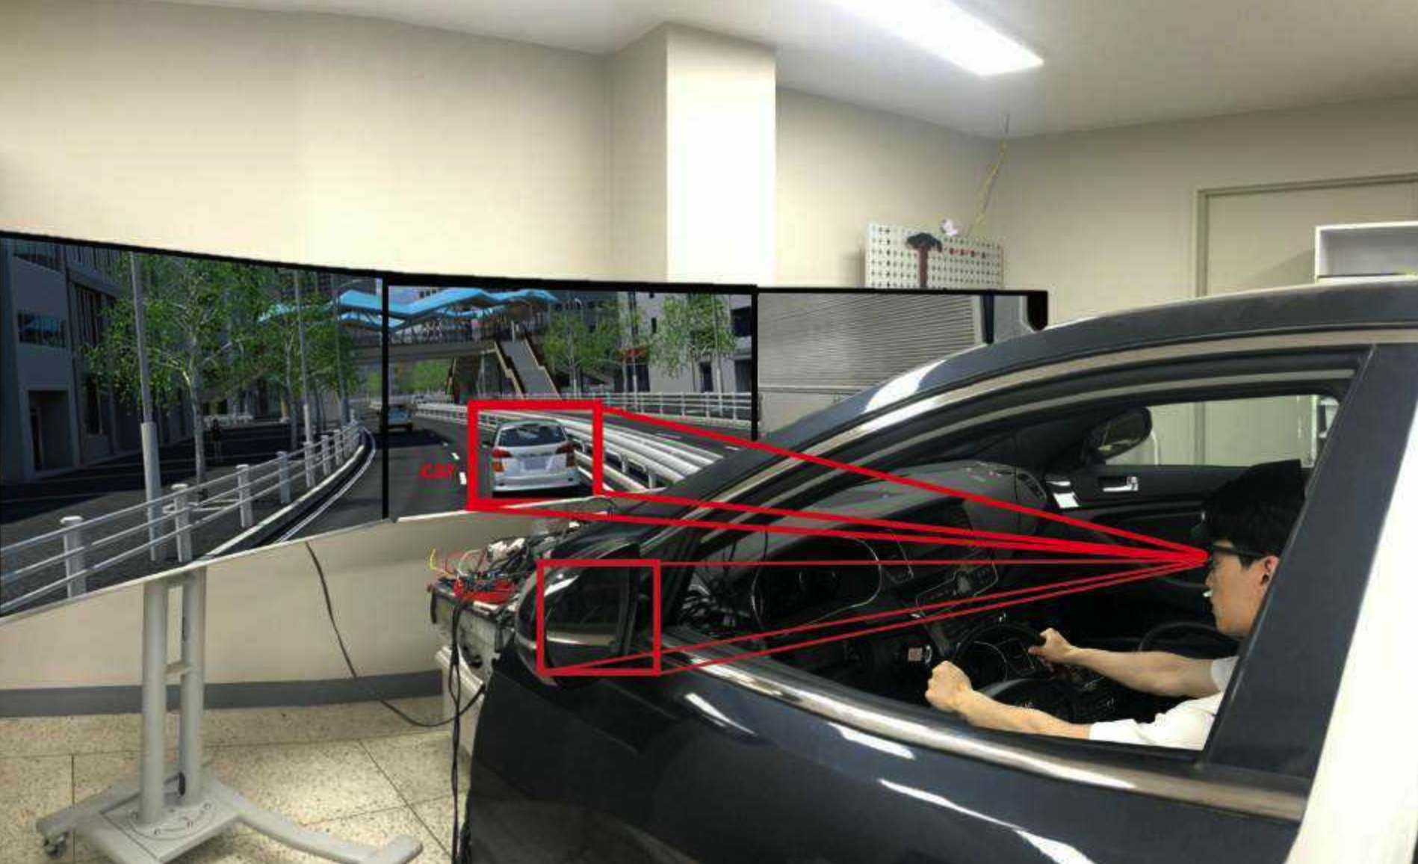
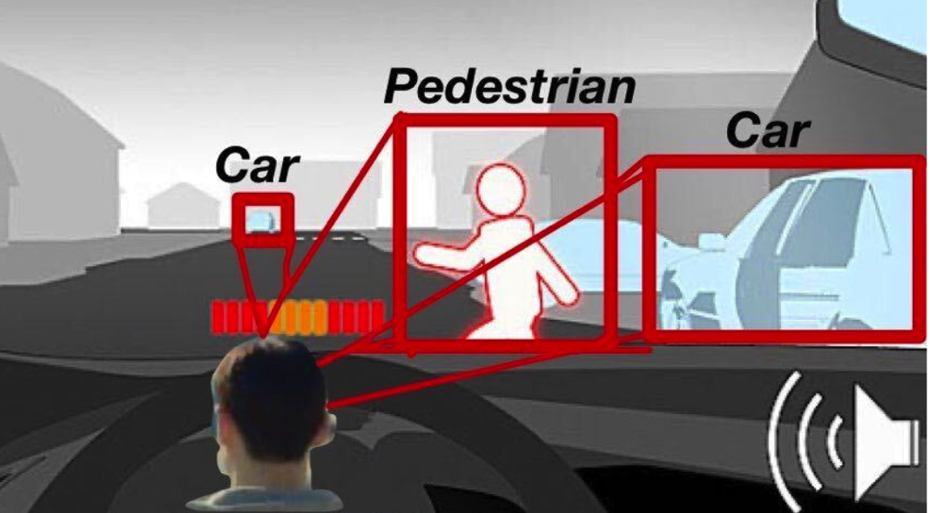
Background
Background
∙ ADAS does not know where the driver’s attention is being focused.
∙ Not possible to determine if the driver is aware of abnormal vehicles or other road hazards.
∙ Unnecessary warnings may sound even if the driver has already detected and prepared for the hazard.
∙ If the driver assistance system has information about the driver's focus of attention, it may suppress unnecessary warnings and can more easily detect the driver's intentions and respond to them.

Slide 4
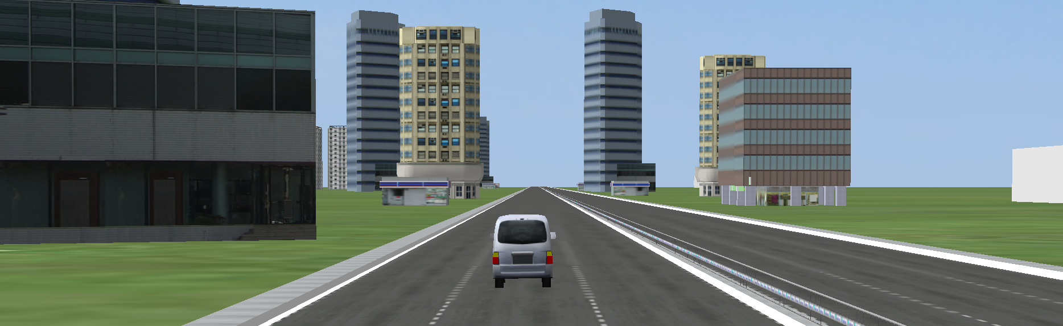
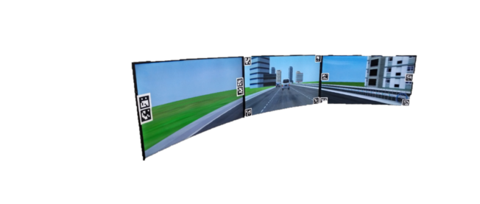
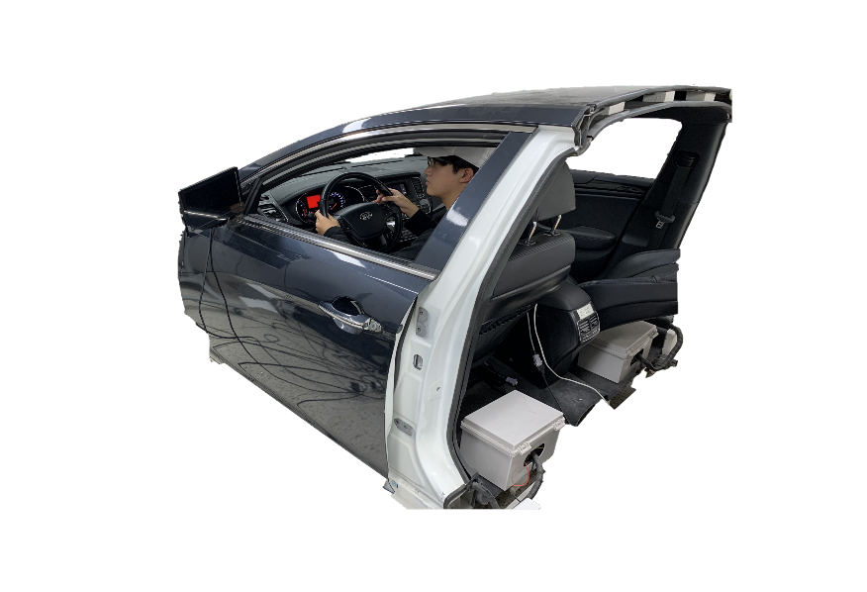
Concept
Concept
In AR environment (Simulator & UC-win/Road)
There is a dog on the road!
Watch out!
My phone is ringing!?
That bus suddenly stopped!
That car just cut in!
Soon it's school zone.
When the driver sees UC-win/Road program in the driving simulator, a Bounding Box is projected on the screen. To the eye, the Bounding Box seems flat. However, a Bounding Box is generated in 3D. Therefore, we can implement the environment like Real World.

Slide 5
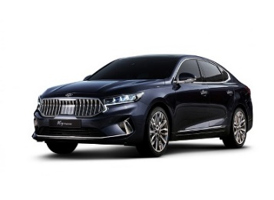
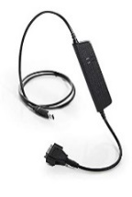
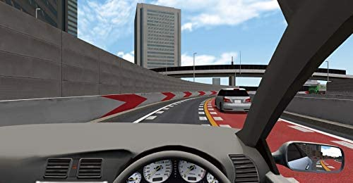


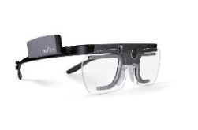
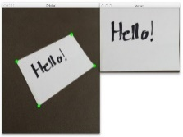
Map
Manipulator
System Configuration Map
In AR environment (Simulator & UC-win/Road)
Manipulator
Manipulator
socket communi-cation
kvaser leaf light v2
Can USB interface
Logitech
Manipulator
socket communi-cation
UC-Win/Road
Tobii glasses2
Eye tracker
user
Perspective Transform

Slide 6
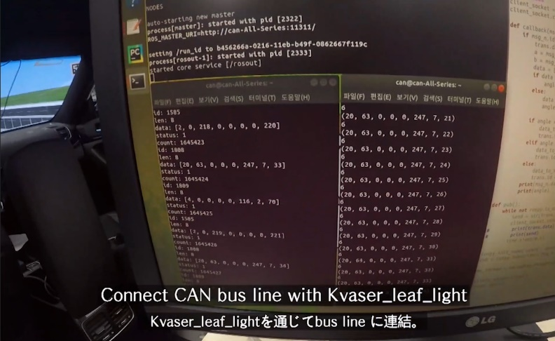
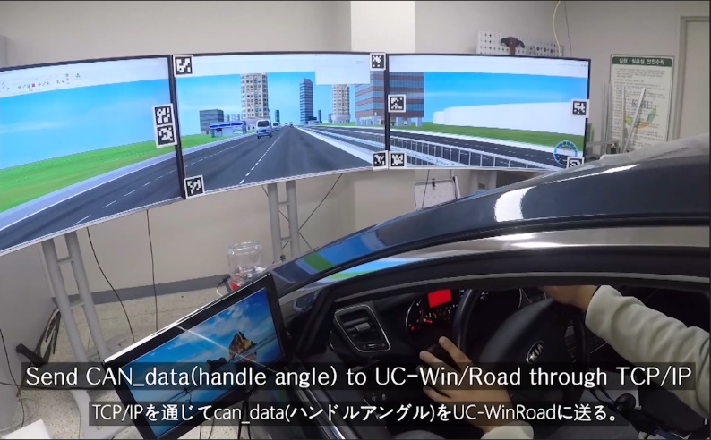
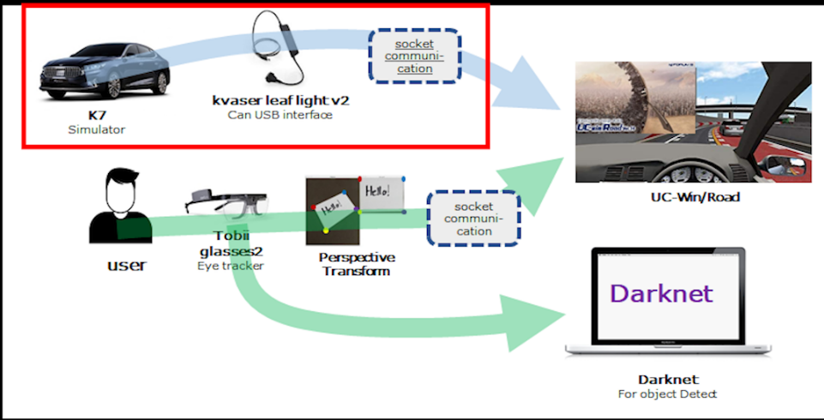
Map
Getting Can Data from Driving Simulator
Step 1.
Connect CAN Bus line with Kvaser_leaf_light
Step 2.
Send CAN data(handle angle) to UC-win/Road through TCP/IP
System Configuration Map

Slide 7
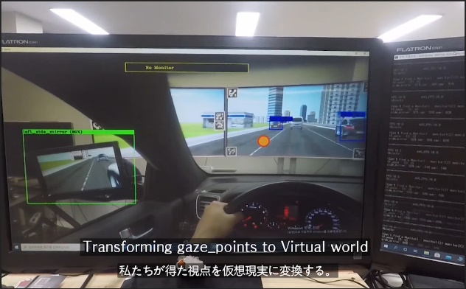
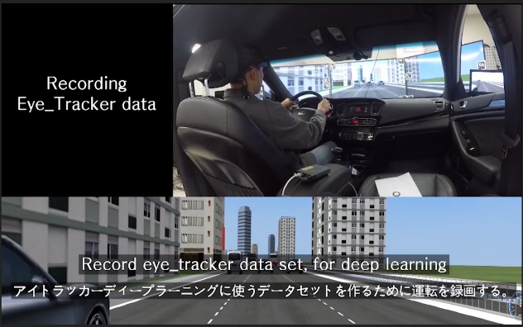
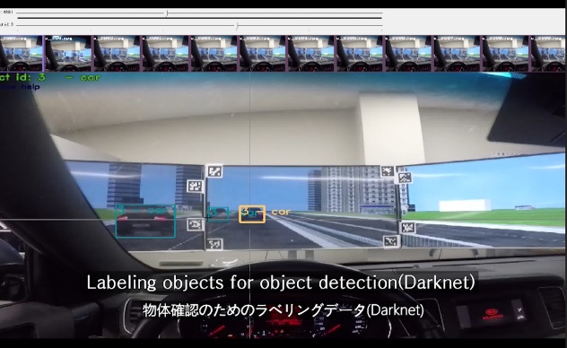
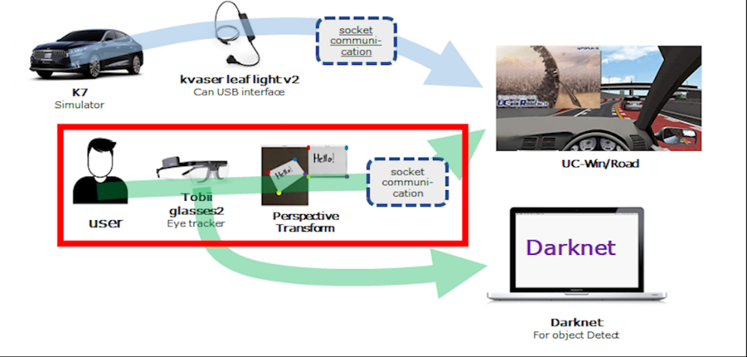
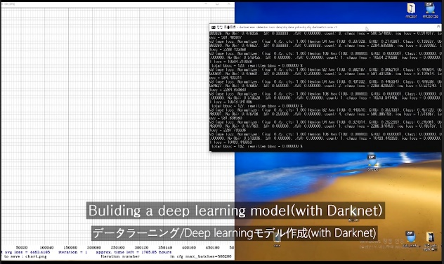
Deep Learning
Object Detection from Eye_Tracker Data
Step 2.
Transforming gaze_point to Virtual world
Step 1.
Record Eye_tracker set, for deep Learning
Step 3.
Labeling objects for object detection(Darknet)
System Configuration Map
Step 4.
Building a Deep Learning model(Darknet)

Slide 8
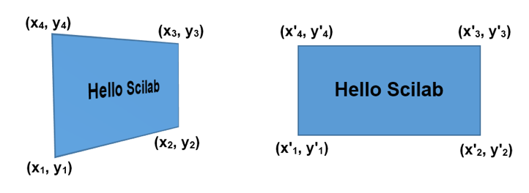
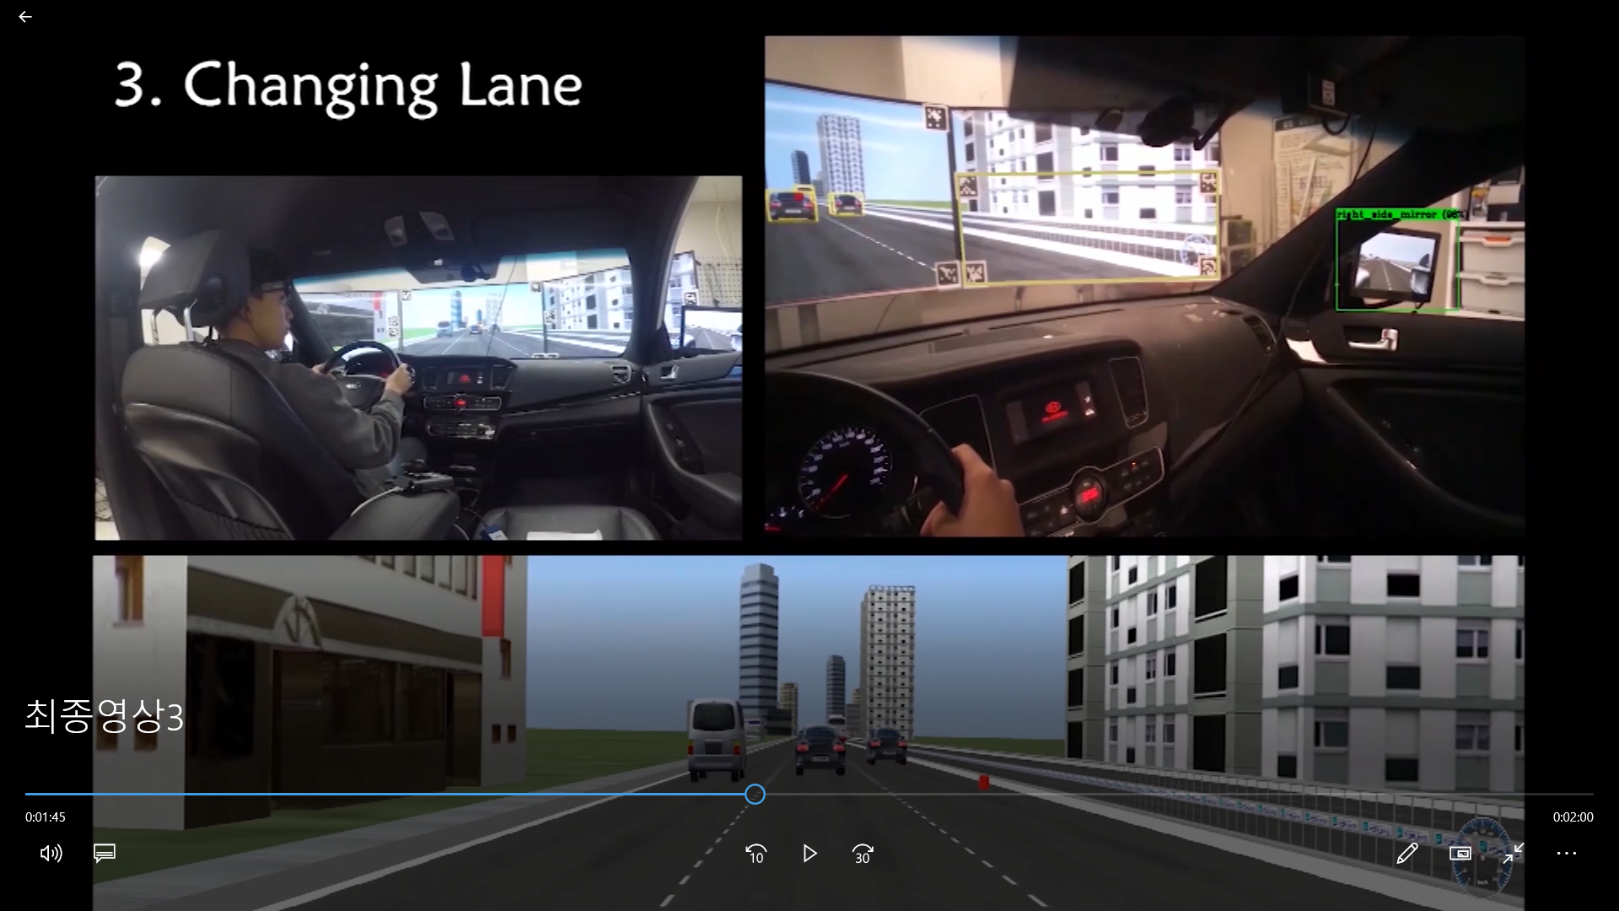
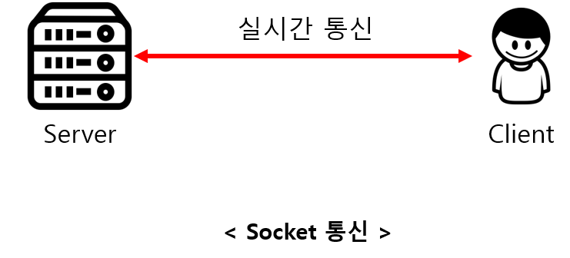
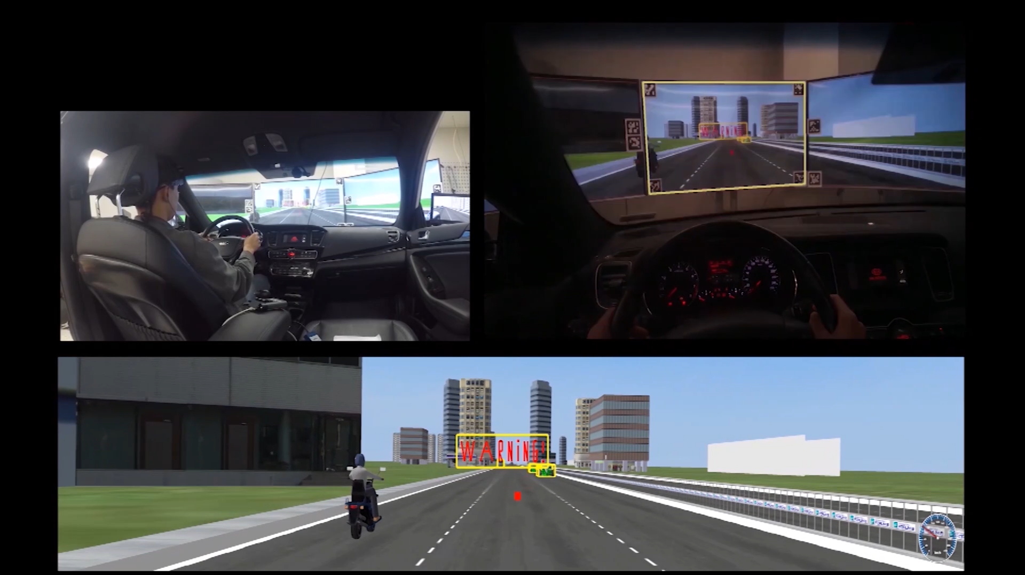
Gaze Point
Gaze Point Transformation to UC-win/Road Screen(1)
In AR environment (Simulator & UC-win/Road)
Step 2.
Perspective Transfrom
Step 1.
Get Gaze_point with Tobii Glasses 2
Step 3.
To UC-win/Road (Socket communication)
System Configuration Map
Step 4.
Draw Bounding Box or “Warning” Sign

Slide 9
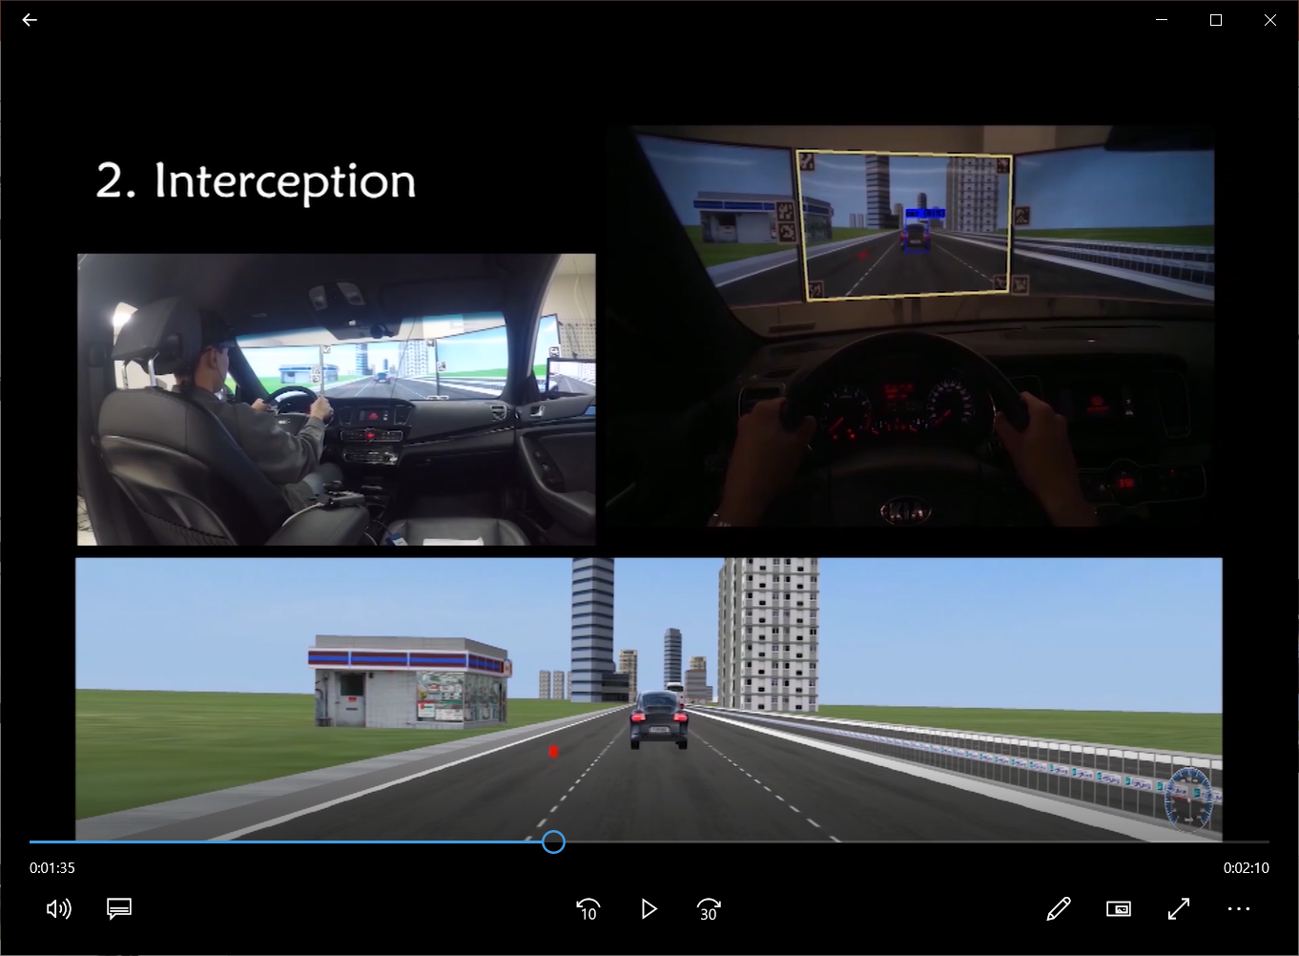
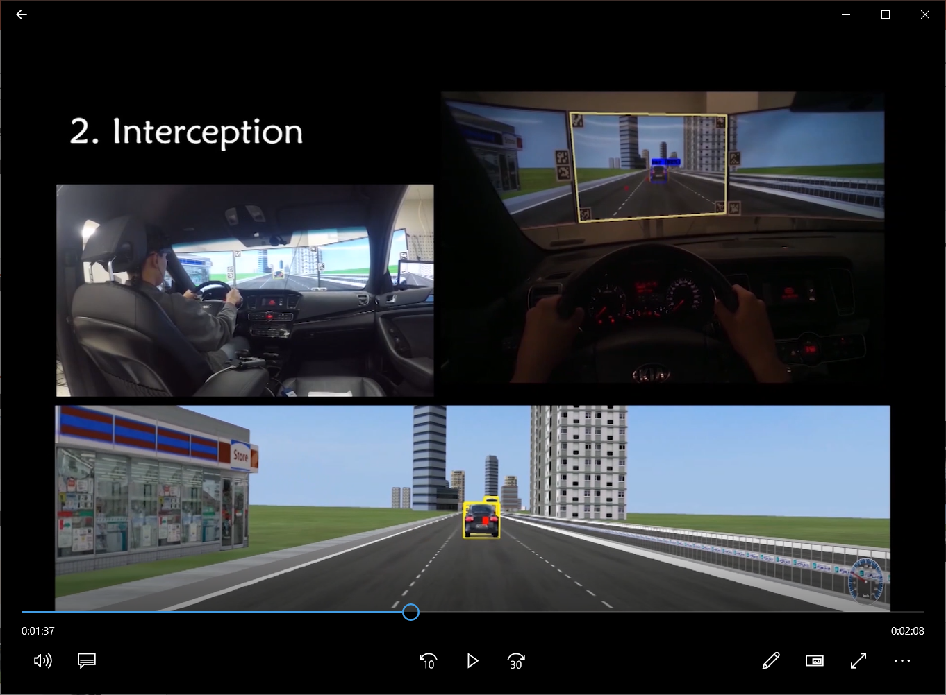
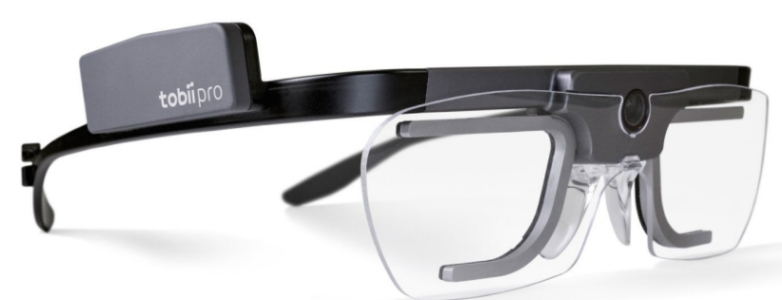

Gaze Point
Gaze Point Transformation to UC-win/Road Screen(2)
In AR environment (Simulator & UC-win/Road)
The Gaze point is marked with a red dot in the UC-win/Road program. And when the Gaze point is on the vehicle, a yellow 3D Binding box is created. As a result, we can visually check which vehicle the driver is looking.

Slide 10
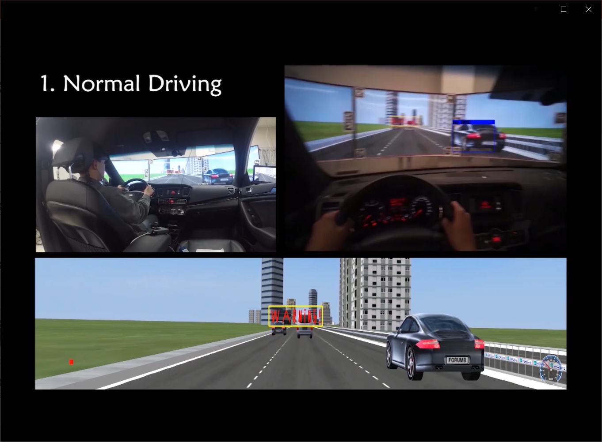
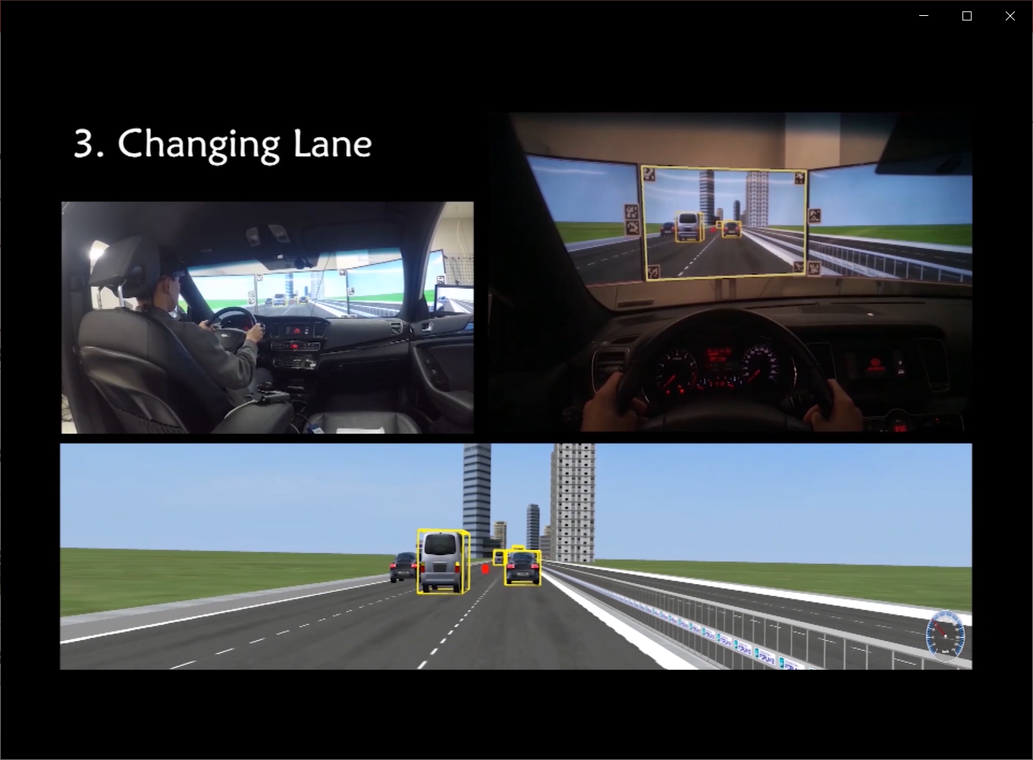
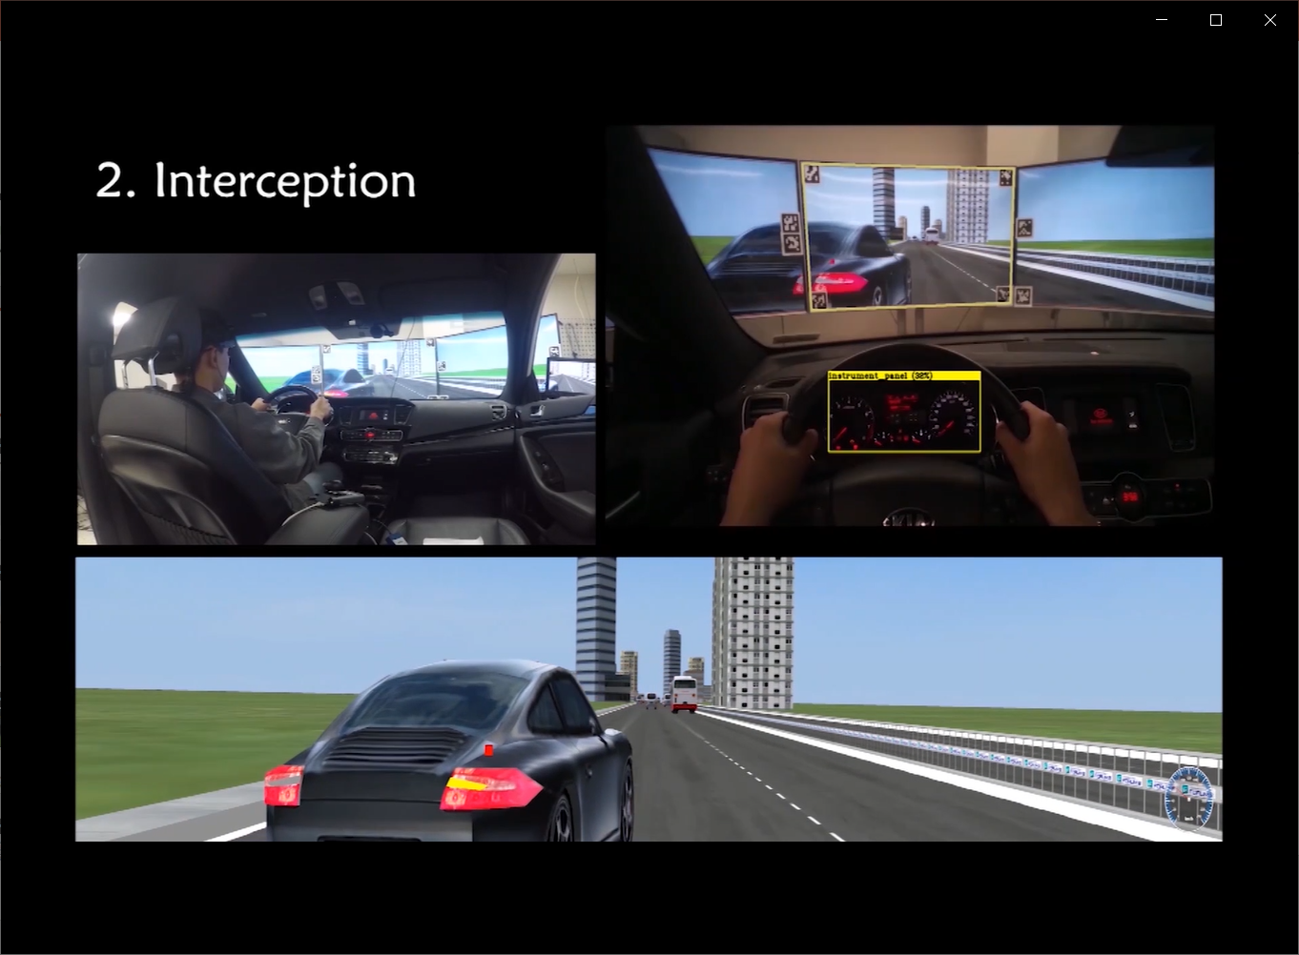
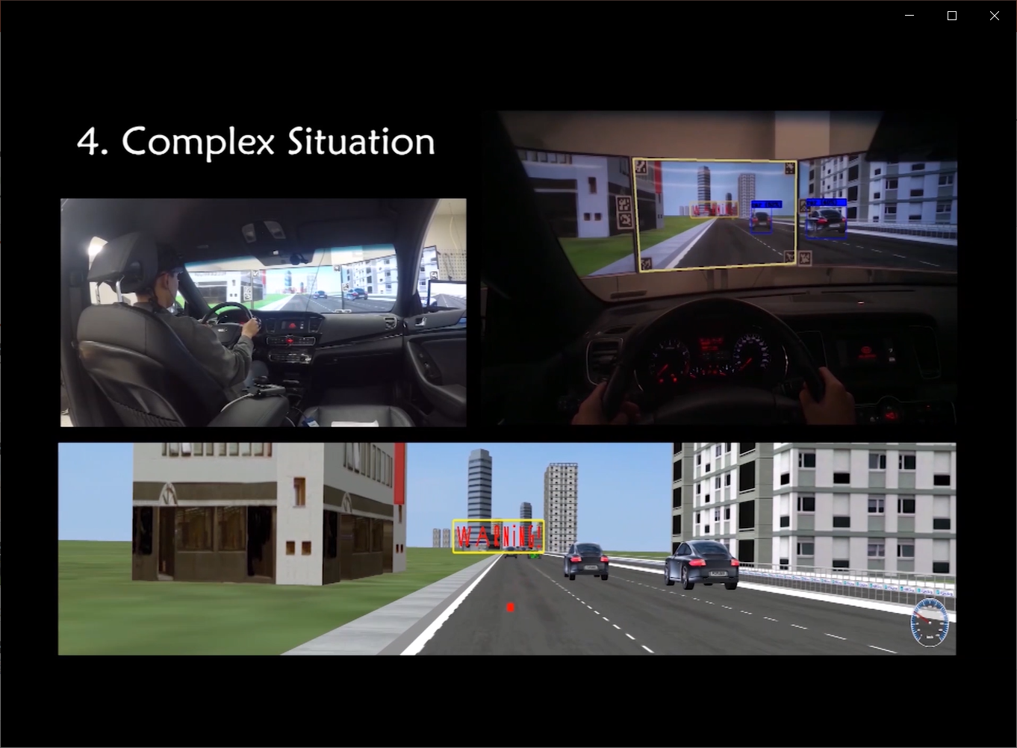
Simulate
Demo Scenario (UC-win/Road World)
The user just go forward
The user change the lane
Another Car intercepted the user’s line
Complex Situation

Slide 11
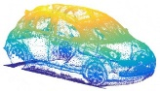
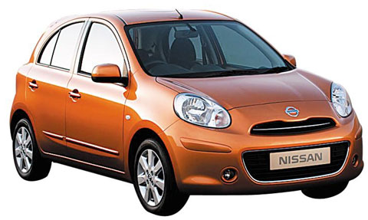
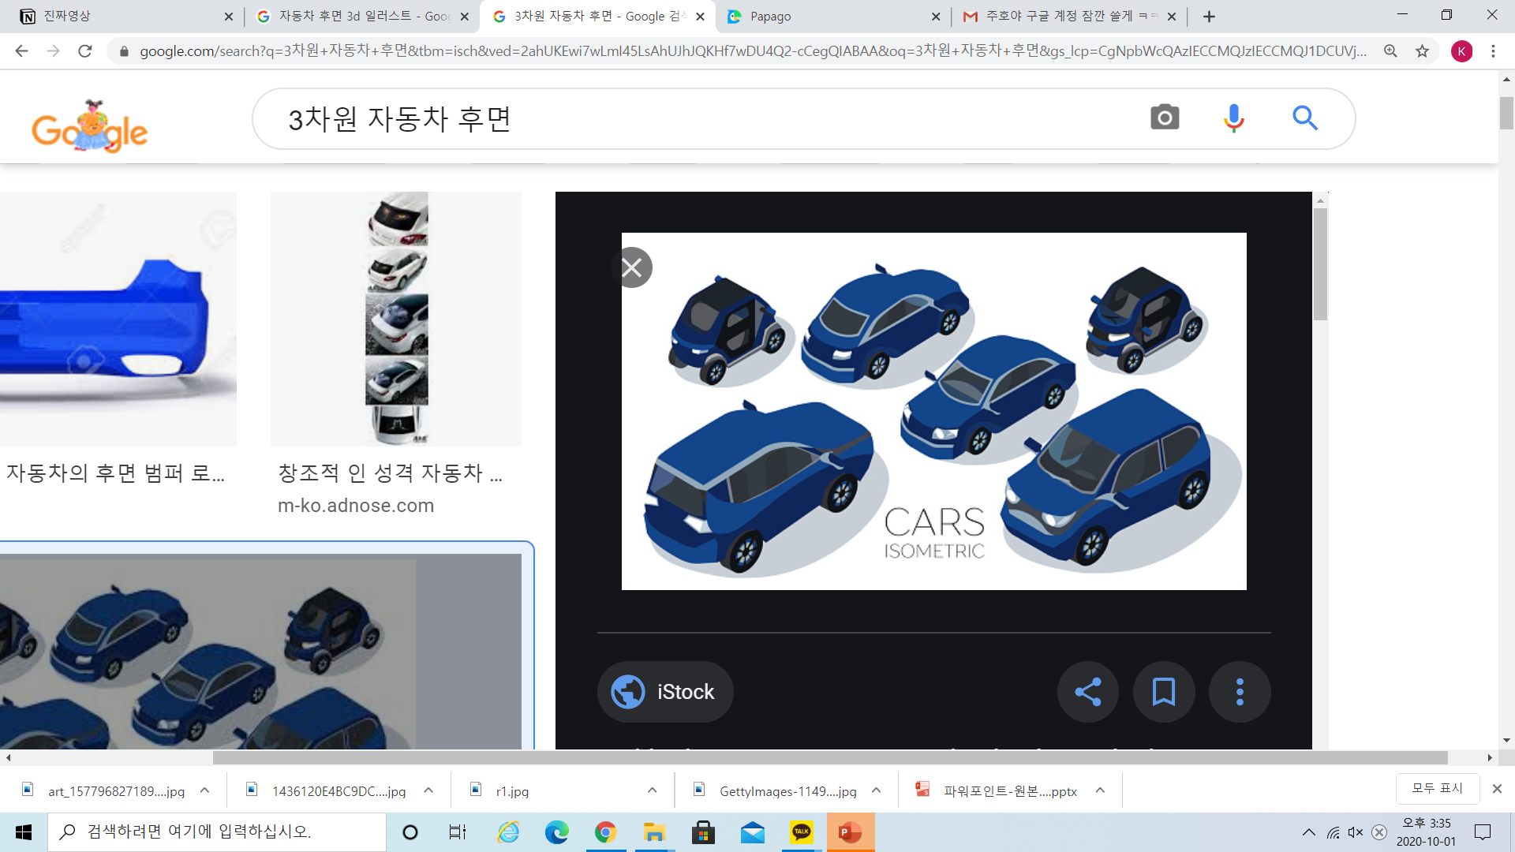
Theory
Applying Eyes 4 Vehicles in Real World.
In Real World ( EyeTracker & Camera & Lidar / Sensor )
Applying Eyes 4 Vehicles in Real World.
1. Camera costs less but has no depth information which leads to 2D object recognition. On the other hand, lidar with great performance and many layers costs alot.
2. So we complemented both camera and lidar to effectively increase recognition accuracy.
3. We used the real-time coordinates of the eye-tracker to figure out which of the objects the driver is looking, among the objects that the lidar and the camera detected.
4. If the driver is not looking at an object related to a particular hazard situation, a warning is given by sound or visual alert system.
5. This system reduces the driver's risk and prevents accidents.
Lidar Point Cloud
(3D)
Eye Tracker Vector
Driver’s sight
360º camera
screen (2D)

Slide 12
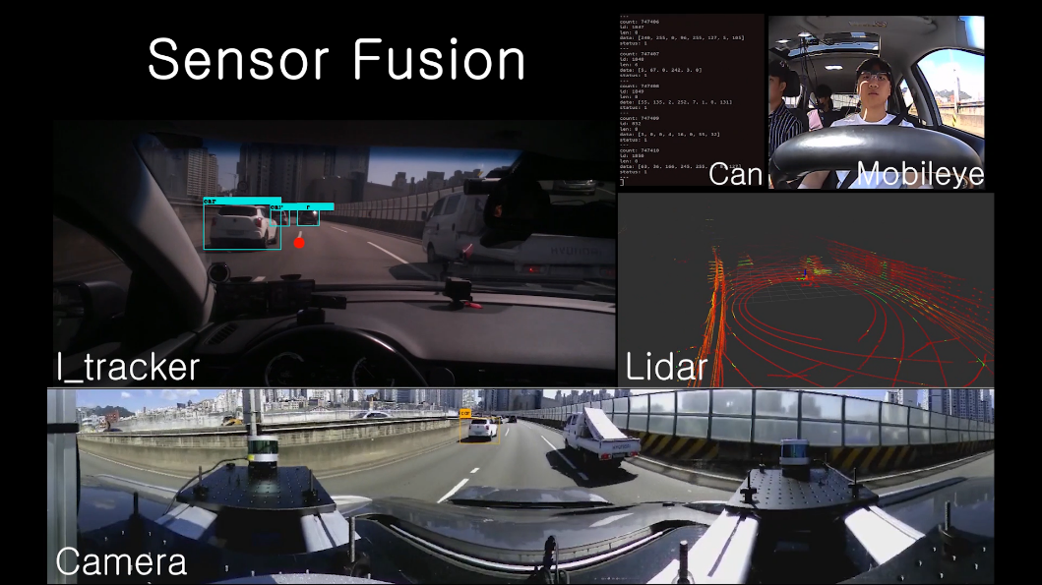
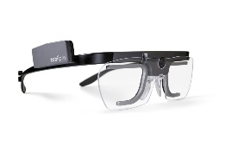
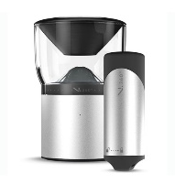
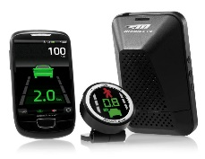


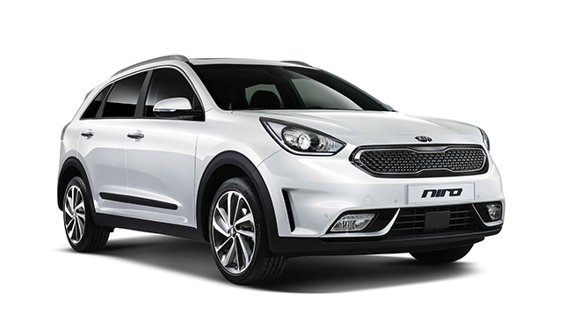
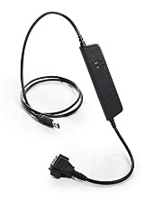
Map
Applying Eyes 4 Vehicles in Real World.
In Real World ( EyeTracker & Camera & Lidar / Sensor )
Tobii glasses 2
Eye Tracker
user
VLP 16
Three Lidar Calibration
V.360
360-degree camera
Mobileye
ADAS System
We can detect objects with our sensor.
With eyeTracker we can support driver ergonomically.
Based on our data collected by our sensors, we can do research on deep learning.
Kvaser leaf light v2
Can USB Interface
Niro
sensor

Slide 13
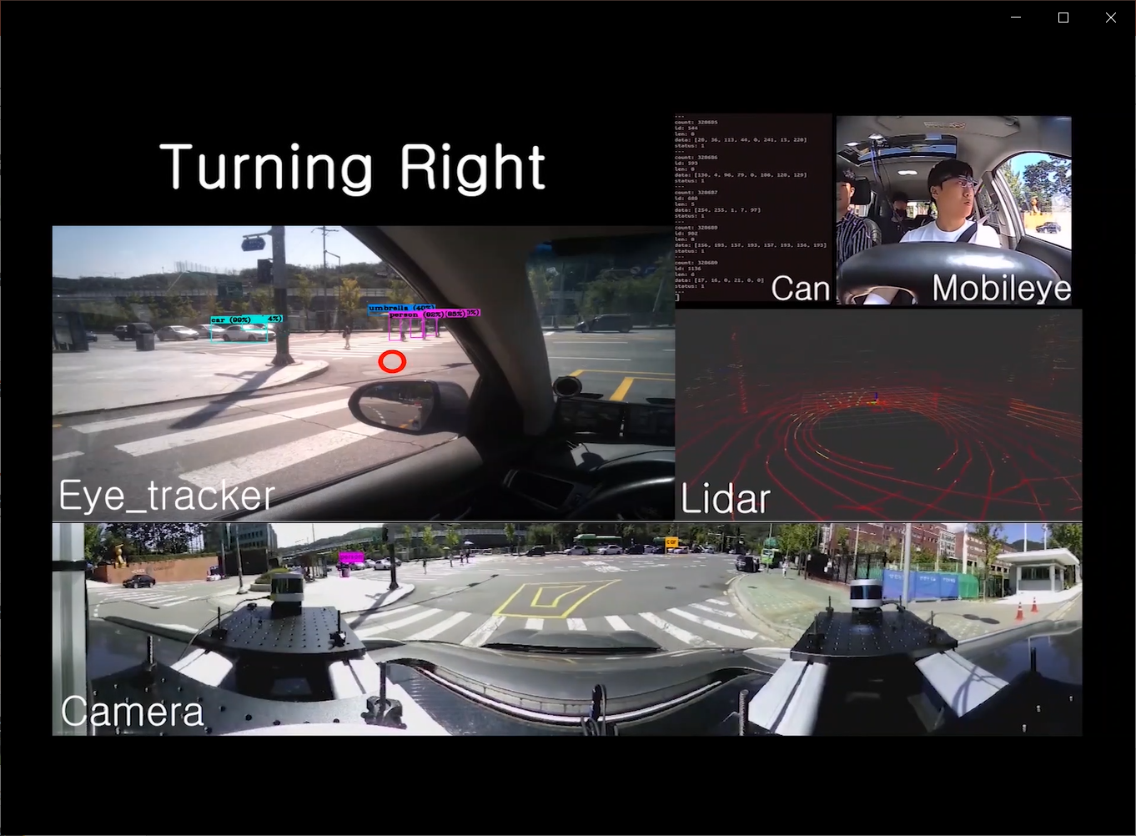
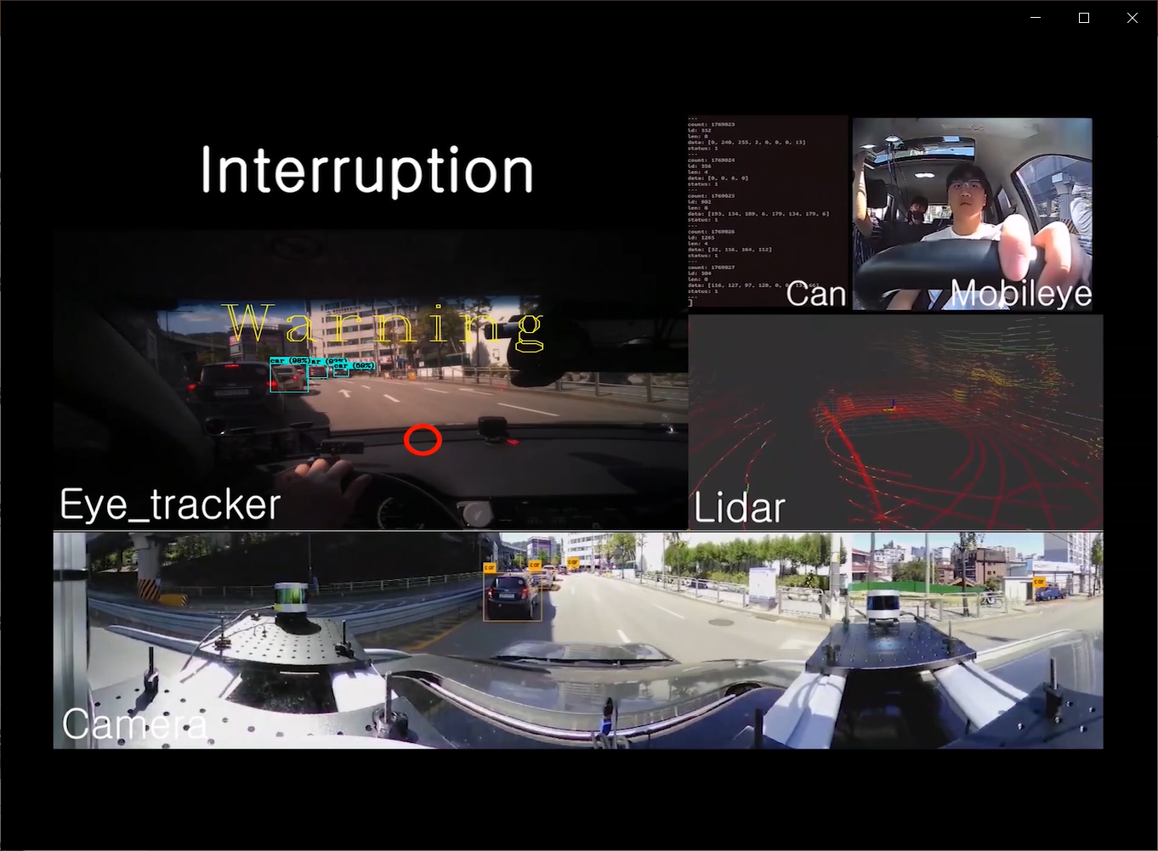
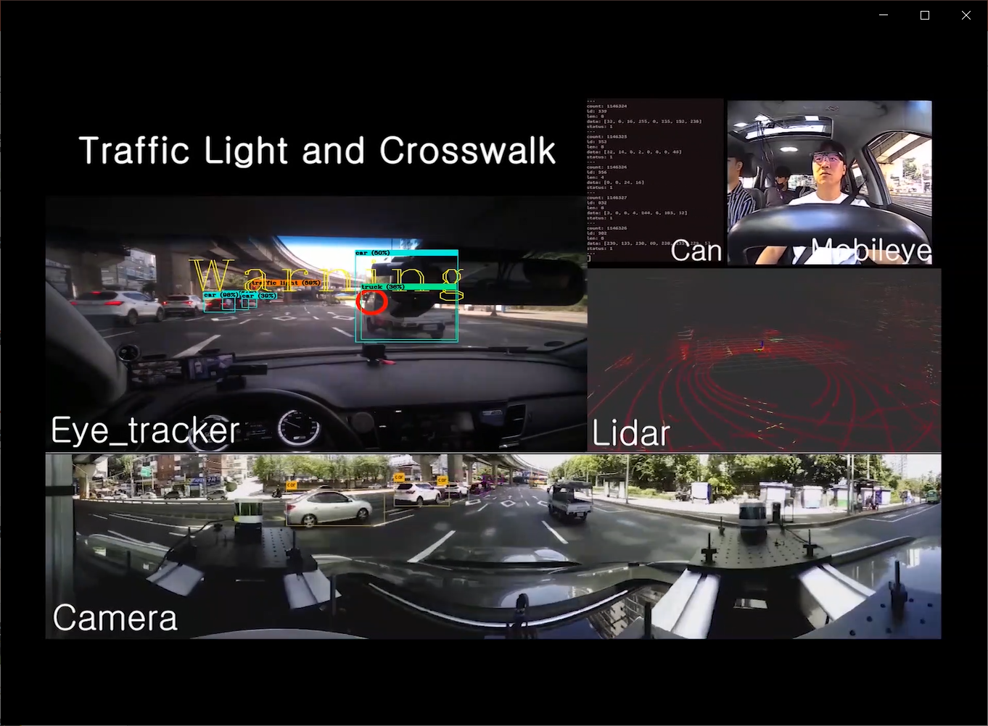
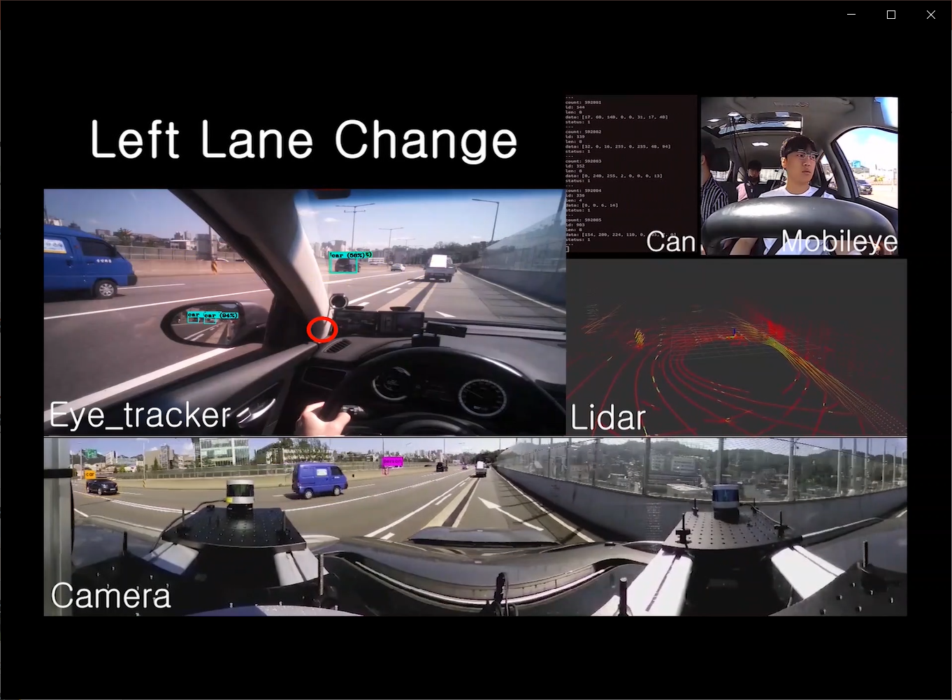
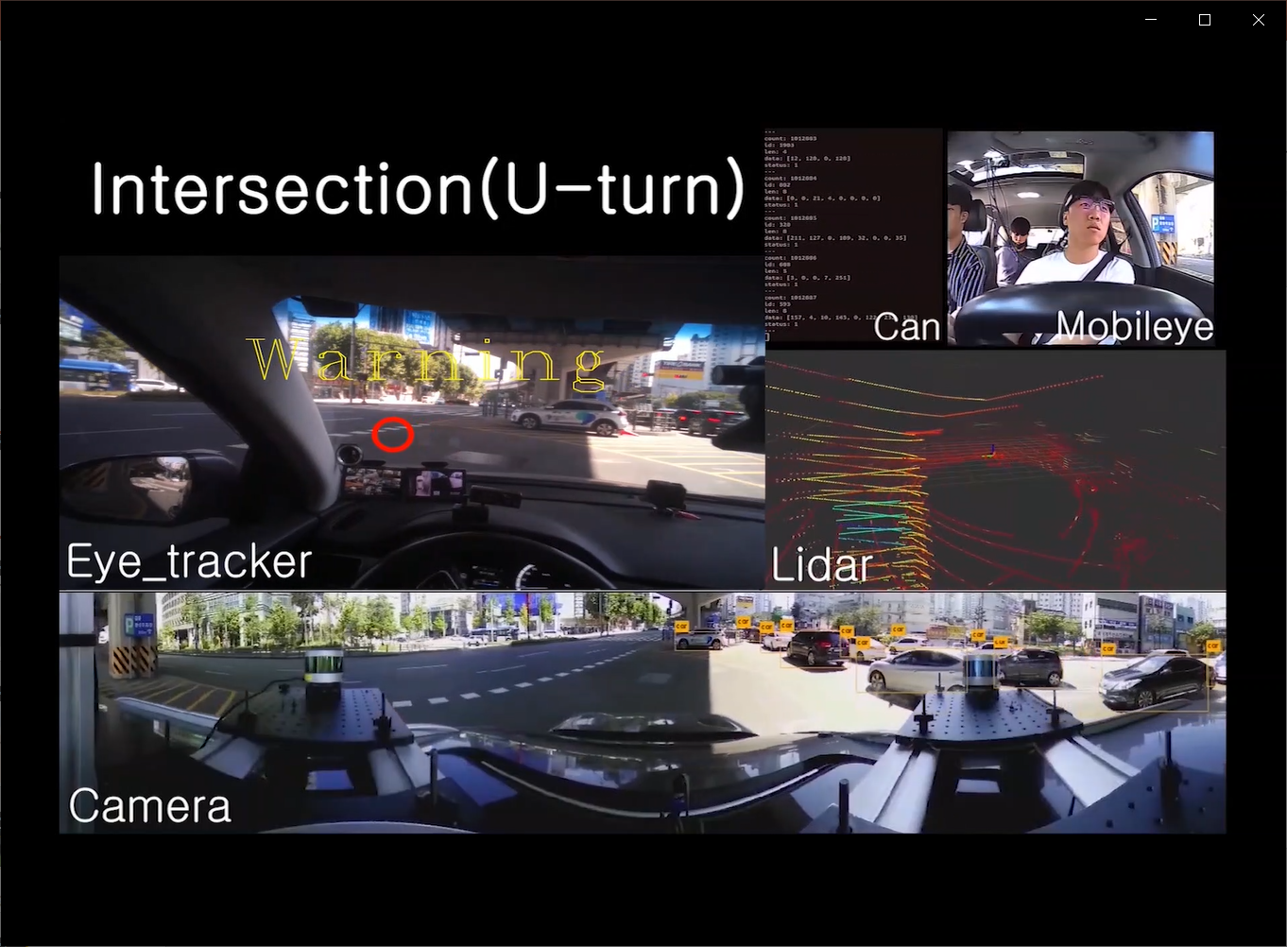
Simulate
Demo Scenario (Real World)
The user turns right
The car in front suddenly interrupted.
Waiting for a green at an intersection
The user turns left
The user makes a U-turn.

Slide 14
Thank you very much for your attention.

Slide 15
Demo.c demo()
Aruco::detectmarkers()
Darknet.c main()
Detector.c run_detector()
Imaage_opencv.cpp get_qrcode_touch_gazepoint()
G_monitor==4
Demo.c draw_detection_cv_v3()
Wrapperspectivetransform()
Getperspectivetransform()

Slide 16
연결 정상인지?
Python
Calibrate_and_record.py
Controller.py
Start_streaming()
Start_calibration()
No_streaming
No_cali
Start_recording()

